Slide 1
Exotic Options
Chapter 25
25.<number>

Slide 2
Types of Exotics
25.<number>
Package
Nonstandard American options
Forward start options
Compound options
Chooser options
Barrier options
Binary options
Lookback options
Shout options
Asian options
Options to exchange one asset for another
Options involving several assets

Slide 3
Packages (page 555)
25.<number>
Portfolios of standard options
Examples from Chapter 10: bull spreads, bear spreads, straddles, etc
Often structured to have zero cost
One popular package is a range forward contract

Slide 4
Non-Standard American Options (page 556)
25.<number>
Exercisable only on specific dates (Bermudans)
Early exercise allowed during only part of life (e.g. there may be an initial “lock out” period)
Strike price changes over the life

Slide 5
Forward Start Options (page 556)
25.<number>
Option starts at a future time, T₁
Most common in employee stock option plans
Often structured so that strike price equals asset price at time T₁

Slide 6
Compound Option (page 557)
25.<number>
Option to buy / sell an option
  Call on call
  Put on call
  Call on put
  Put on put
Can be valued analytically
Price is quite low compared with a regular option

Slide 7
Chooser Option “As You Like It” (page 558)
25.<number>
Option starts at time 0, matures at T₂
At T₁ (0 < T₁ < T₂) buyer chooses whether it is a put or call
A few lines of algebra shows that this is a package

Slide 8
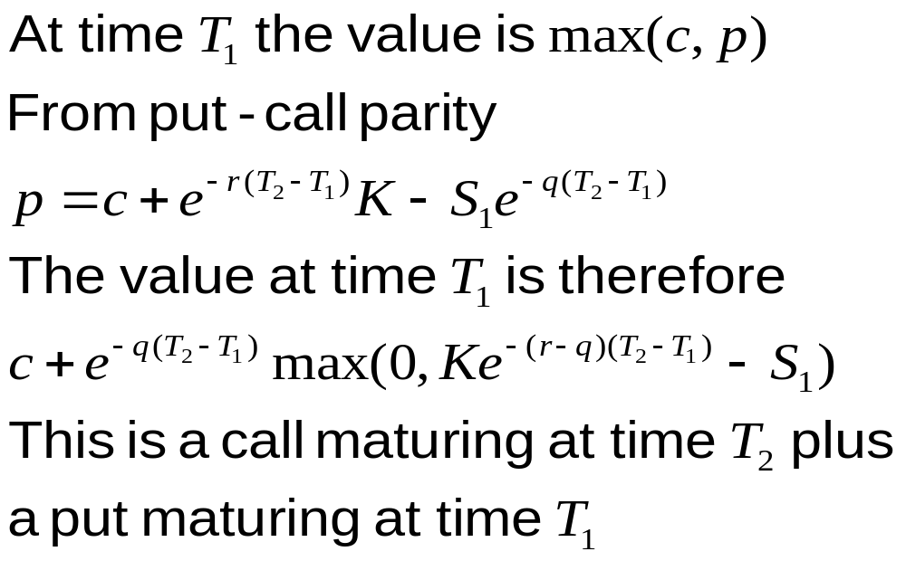
Chooser Option as a Package
25.<number>

Slide 9
Barrier Options (page 558)
25.<number>
Option comes into existence only if stock price hits barrier before option maturity
  ‘In’ options
Option dies if stock price hits barrier before option maturity
  ‘Out’ options

Slide 10
Barrier Options (continued)
25.<number>
Stock price must hit barrier from below
  ‘Up’ options
Stock price must hit barrier from above
  ‘Down’ options
Option may be a put or a call
Eight possible combinations

Slide 11
Parity Relations
25.<number>
c = c_{ui} + c_{uo}
c = c_{di} + c_{do}
p = p_{ui} + p_{uo}
p = p_{di} + p_{do}

Slide 12
Binary Options (page 561)
25.<number>
Cash-or-nothing: pays Q if S > K at time T, otherwise pays 0. Value = e^{–rT} Q N(d₂)
Asset-or-nothing: pays S if S > K at time T, otherwise pays 0. Value = S₀ N(d₁)

Slide 13
Decomposition of a Call Option
25.<number>
Long Asset-or-Nothing option
Short Cash-or-Nothing option where payoff is K
Value = S₀ N(d₁) – e^{–rT} KN(d₂)

Slide 14
Lookback Options (page 561)
25.<number>
Lookback call pays S_{T} – S_{min} at time T
Allows buyer to buy stock at lowest observed price in some interval of time
Lookback put pays S_{max}– S_{T} at time T
Allows buyer to sell stock at highest observed price in some interval of time

Slide 15
Shout Options (page 563)
25.<number>
Buyer can ‘shout’ once during option life
Final payoff is either
  Usual option payoff, max(S_{T} – K, 0), or
  Intrinsic value at time of shout, S_{τ} – K
Payoff: max(S_{T} – S_{τ} , 0) + S_{τ} – K
Similar to lookback option but cheaper
How can a binomial tree be used to value a shout option?

Slide 16
Asian Options (page 564)
25.<number>
Payoff related to average stock price
Average Price options pay:
  max(S_{ave} – K, 0) (call), or
  max(K – S_{ave} , 0) (put)
Average Strike options pay:
  max(S_{T} – S_{ave} , 0) (call), or
  max(S_{ave} – S_{T} , 0) (put)

Slide 17
Asian Options
25.<number>
No analytic solution
Can be valued by assuming (as an approximation) that the average stock price is lognormally distributed

Slide 18
Exchange Options (page 566)
25.<number>
Option to exchange one asset for another
For example, an option to exchange U for V
Payoff is max(V_{T} – U_{T}, 0)

Slide 19
Basket Options (page 567)
25.<number>
A basket option is an option to buy or sell a portfolio of assets
This can be valued by calculating the first two moments of the value of the basket and then assuming it is lognormal

Slide 20
How Difficult is it to
Hedge Exotic Options?
25.<number>
In some cases exotic options are easier to hedge than the corresponding vanilla options.
(e.g., Asian options)
In other cases they are more difficult to hedge (e.g., barrier options)

Slide 21
Static Options Replication
(Section 24.14, page 570)
25.<number>
This involves approximately replicating an exotic option with a portfolio of vanilla options
Underlying principle: if we match the value of an exotic option on some boundary , we have matched it at all interior points of the boundary
Static options replication can be contrasted with dynamic options replication where we have to trade continuously to match the option

Slide 22
Example
25.<number>
A 9-month up-and-out call option an a non-dividend paying stock where S₀ = 50, K = 50, the barrier is 60, r = 10%, and σ = 30%
Any boundary can be chosen but the natural one is
c (S, 0.75) = MAX(S – 50, 0) when S < 60
c (60, t ) = 0 when 0 ≤ t ≤ 0.75

Slide 23
Example (continued)
25.<number>
We might try to match the following points on the boundary
c(S , 0.75) = MAX(S – 50, 0) for S < 60
c(60, 0.50) = 0
c(60, 0.25) = 0
c(60, 0.00) = 0

Slide 24
Example continued
(See Table 24.1, page 572)
25.<number>
We can do this as follows:
+1.00 call with maturity 0.75 & strike 50
–2.66 call with maturity 0.75 & strike 60
+0.97 call with maturity 0.50 & strike 60
+0.28 call with maturity 0.25 & strike 60

Slide 25
Example (continued)
25.<number>
This portfolio is worth 0.73 at time zero compared with 0.31 for the up-and out option
As we use more options the value of the replicating portfolio converges to the value of the exotic option
For example, with 18 points matched on the horizontal boundary the value of the replicating portfolio reduces to 0.38; with 100 points being matched it reduces to 0.32

Slide 26
Using Static Options Replication
25.<number>
To hedge an exotic option we short the portfolio that replicates the boundary conditions
The portfolio must be unwound when any part of the boundary is reached

